Slide 1
Speed

Slide 2
By the end of the lesson, you should be able to:
Define speed.
State the formula for calculating speed.
Calculate speed using distance and time.

Slide 3
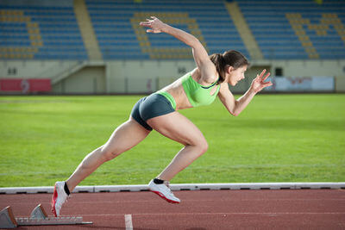
Speed describes how fast something is moving.
It is defined as the change in distance over change in time.
We measure speed in metres per second (m/s), which can also be written as ms⁻¹.

Slide 4

Delta: The symbol for change
In physics, we call the change in distance Δd and the change in time Δt.
The Δ symbol is the Greek letter Delta, and means "change in." For example, a stopwatch measures changes in time.

Slide 5
We can use this formula to calculate speed:
speed=distance
time​
We express this with the following mathematical notation:
v=Δd​
Δt
Here v stands for velocity, which is related to speed - we'll explain this soon.

Slide 6
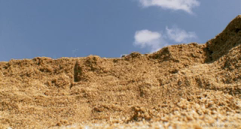
We can also rearrange this formula to find the distance that an object travels in a certain time.
distance=speed×time
Δd=v×Δt

Slide 7

Finally, we can rearrange for the time it takes an object to travel a distance.
time=distance
velocity​
Δt=Δd
v​

Slide 8
Speed vs. Velocity
The terms speed and velocity of are often used interchangeably. However, there is a subtle but very important difference!
Speed is a scalar quantity. This means that it has a magnitude (size), but no direction - it's just a number. We know this because we use distance, another scalar quantity, to calculate speed. | Velocity is a vector quantity. This means it has a magnitude (size) AND a direction. Therefore, we would use displacement (the vector form of distance) to calculate velocity.

Slide 9
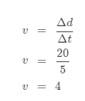
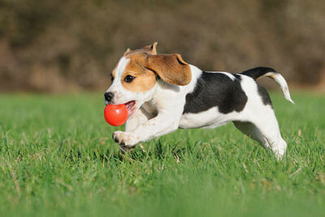
Lucy is taking her puppy to a dog park. When she throws the ball, the puppy runs 20 m to catch it. Lucy was timing the puppy, and she found that it only took 5 s to run that far.
What is the speed of the puppy?
Speed has units of m/s, so the speed of the puppy is v=4 m/s.

